Slide 1
Statistics
Author: Gustavo Zarate

Slide 2
The different types of characters and statistical variables
Qualitative characteristics: they do not reflect a measure. Their modalities are generally not ordered.
All the possible methods are listed in a nomenclature.
Discrete quantitative characters: they translate one or more measurements.
precisely a count. Their modalities are isolated numbers; they are usually integers.
If there is a very large number of modalities, the variable will be assimilated to a continuous variable.
Continuous Quantitative Characteristics: They reflect a measurement and
are expressed by a number whose possible values form a continuous set, or a very large number of isolated values.

Slide 3
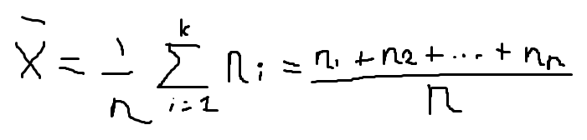
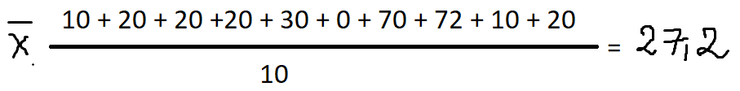
Mean
Scores example
Student 1 = 10
Student 2 = 20
Student 3 = 20
Student 4 = 20
Student 5 = 30
Student 6 = 0
Student 7 = 70
Student 8 = 72
Student 9 = 10
Student 10 = 20

Slide 4
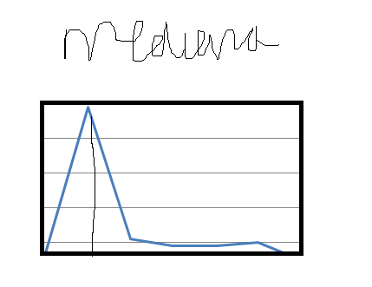

Slide 5
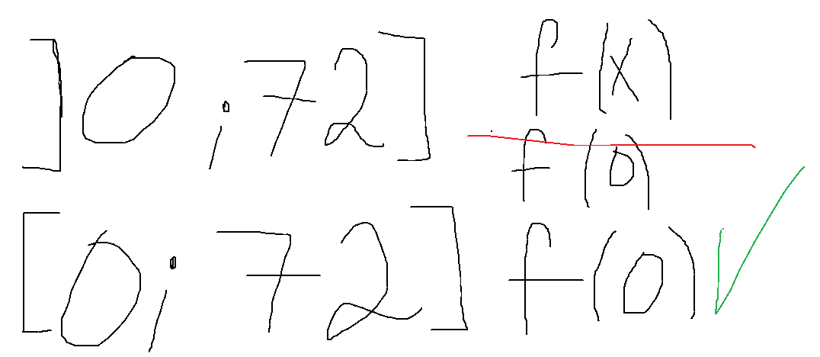

Slide 6
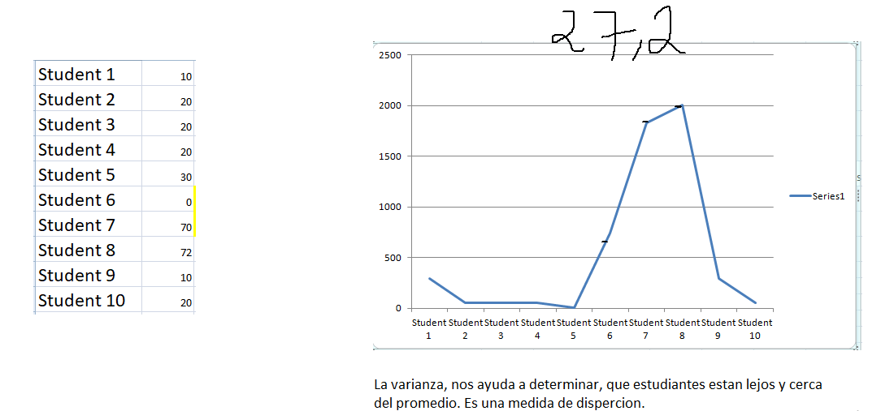

Slide 7
